Slide 1
Topic name: Text analysis of online reviews of Dating apps(Bumble, Hinge, Tinder,okCupid)
Group Number 9
Members:
Abhishek Das - 3A Adrik Sensarma - 4A Karthikeyan A - 14A N V Ajay - 22A Saiteja Korada - 30A

Slide 2
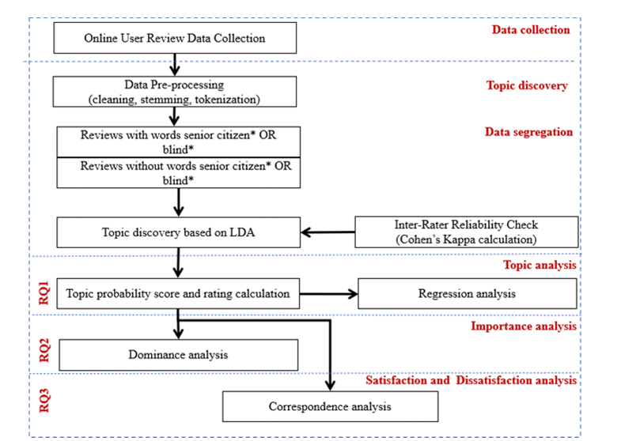
Steps performed

Slide 3
Data source
We conducted a web scraping project to gather reviews from popular dating apps on the Google Play Store, focusing on Bumble, Hinge, Tinder, and OkCupid. Our project on Dating Apps Analysis, involved extracting a total of 764,386 reviews distributed across the apps: 154,771 from Bumble, 400,001 from Tinder, 70,717 from Hinge, and 138,897 from OkCupid. The data extracted from the Google Play Store included user IDs, review texts, ratings, and review dates. The reviews were contributed only by users who had signed up, making them trustworthy. To ensure the quality and consistency of the data, we applied two main criteria: maintaining an equal proportion of review scores across the apps and selecting reviews with a minimum of 20 words to avoid issues of sparsity and noise in short texts. The reviews were collected in descending order of recency, covering a temporal range from November 2015 to July 2024, with a majority being the latest submissions. Initially, the dataset included many short reviews and duplicates, totaling 529,126, which were subsequently removed. This left us with 235,260 reviews suitable for analysis. However, due to system constraints, we worked with a sample of 100,000 reviews. We encountered language variations, with reviews in both Hindi and English, and utilized a custom function to translate common Hindi slang and terms into English. Reviews in Arabic were excluded from the analysis.

Slide 4
Data pre processing
Text Cleaning: Removed language-specific text and HTML tags from web crawling.
Tokenization: Split review texts into individual words (tokens) for detailed analysis.
Preprocessing:
Expanded contractions and converted all words to lowercase.
Corrected spelling errors and eliminated duplicated characters using Python algorithms.
Applied Lemmatization to convert words to their base forms.
Stop Words Removal: Removed common stop words that do not carry significant meaning, such as 'the', 'is', 'in', etc.
Lemmatization: Reduced words to their base or root forms (e.g., 'running', 'ran', 'runs' to 'run') to standardize text data.
Libraries Used: NLTK, Sci-kit, and Gensim for machine learning, natural language processing.

Slide 5
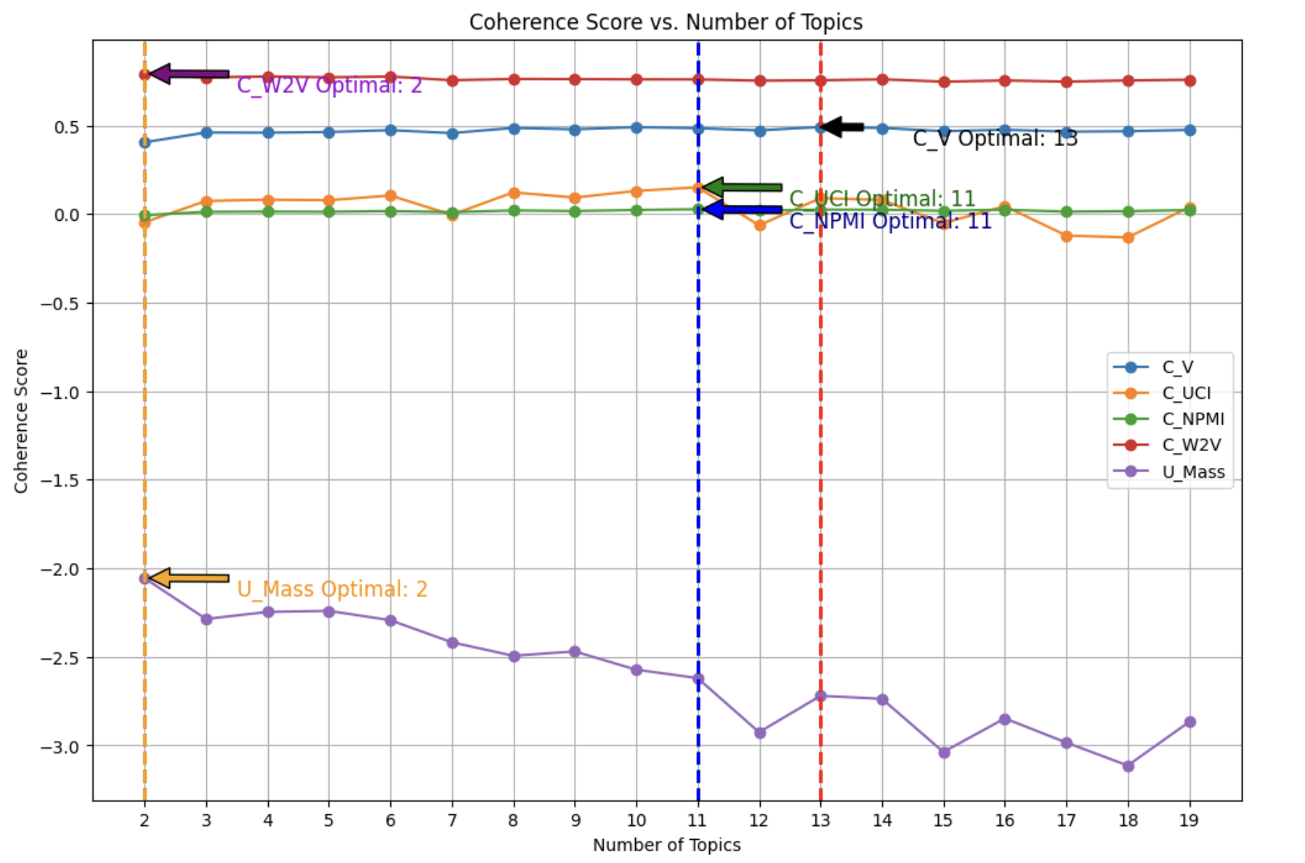
Topic discovery using LDA
Identified the optimum number of topics = 13 (Based on CV Score)

Slide 6
Topic identified
Interpretation of factors.
Serial Number | Terms per Topic | Interpreted Topic
Topic 1 | app, match, pay, like, time, money, premium, profile, free, dating | In-app Payments
Topic 2 | woman, first, girl, match, app, like, guy, tinder, bumble, give | User Interaction
Topic 3 | like, people, app, profile, would, question, good, match, person, see | Profile Quality
Topic 4 | like, people, see, pay, app, match, free, liked, away, tinder | Features
Topic 5 | message, app, match, notification, back, time, new, update, fix, give | Notification Alerts
Topic 6 | subscription, app, payment, card, cancel, month, money, play, option, paid | Subscription Payment Issues
Topic 7 | swipe, right, left, swiped, swiping, app, profile, time, like, people | Profile Matches
Topic 8 | account, banned, reason, app, got, support, service, tinder, customer, give | Customer Support
Topic 9 | app, woman, filter, men, people, location, looking, option, want, age | Profile Filtering
Topic 10 | account, profile, fake, tinder, app, user, delete, bot, instagram, trying | Fake Accounts
Topic 11 | year, tinder, month, due, found, ago, app, got, thanks, day | Subscription Model
Topic 12 | app, work, use, photo, time, number, tried, casebook, picture, wont | Usability
Topic 13 | app, people, dating, good, give, love, best, great, meet, find | User Experience on Finding Matches, Meeting, Dating
Labels of identified topics

Slide 7
Sample review for each topic
Topic name | Sample review 1 | Sample review 2
User Experience on Finding Matches, Meeting, and Dating | You cant change human nature. In the way that this app seeks to differentiate itself it cant scale the wall it seeks to climb. In failing to do what they set out to they make themselves indistinguishable from their competitors. Its not a bad app just not the one im sure they wish it was. | Yeah, it's a dating app, so of course it kinda sucks and everybody hates it because most of the people using it donot want to be using it. But out of all the dating apps out there, this one is by far the best if you're taking it even just a little bit seriously.
Profile Quality | "Online Dating For Every Single Person" is literally a lie from their latest advertisements. Further evidenced by their extra choices instead of the two real ones, you canot even filter those out since I know for a fact I'm 0% compatible with any of those people. Also canot filter by "happy with the Dobbs decision bc unique DNA=unique body" | 2/5 stars cause at least there are more people on this app. Also pay to play so, remember to bring the wallet. Still a ton of bots/fake accounts.
Fake Accounts | 99 percent Tinder photo and person are fake.Donot pay a dime to Tinder.I am happy that I came out early.Tinder pay girls to give their illicit photo to get money from man.Donot fall on the trap. | About half the profiles are fake computer bots using tinder and snapchat to promote a paid service like webcam, pictures for sale or another website. Donot waste your money on Tinder, it's garbage. I complained to Tinder by email then my account was suddenly banned without notice. Nobody from Tinder bothered to reply to my email complaint about all the fake computer profiles. They're doing nothing to prevent it from happening.
In-app Payments | "The app is expensive and a waste of time. You have to pay for premium in order to change your location, which is not a common feature in most dating apps. This limitation has resulted in me receiving very few likes. Based on my personal experience, I prefer Hinge over this app, which I find better than tinder trash | 1 year ago it was possible to do specific researches without having to modify your profile and I was well happy to pay the extremely high cost of your subscription. Then you cancelled the option and I unsubscribed. Now you've made it impossible to send an intro to somebody you arenot matched yet and I am deleting the app. You are ridicolous. You have great features that make your app better than any other dating app and you end up cancelling those very features?! Uninstalling. Tinder is better.

Slide 8
Sample review for each topic..(contd)
Topic name | Sample review 1 | Sample review 2
Notification alerts | "Consent to Term & Conditions" popping out literally every second (even though I agreed to all!!) just drives me crazy. It makes the app impossible to use. Please fix this before I die of banging my head on the wall. | A good premise, but it can be super buggy...lags on profiles, no notifications (even when notifications are on), chats momentarily disappear, etc
Subscription Payment Issues | The app interface is an advanced puzzle. - New message alerts remain lit even there's no message to read. - You subscribe paying an amount in a particular currency and when they change for the renewal, they change the currency to USD, without converting the amount correctly as per the exchange rate. | A scam.. after subscription they banned me for nothing with just a clarification that if you have a subscription cancel it through the provider... no reasons for ban no reply from support. Or even no refund for the subscription.. they are just scamming by their brand name as its well known.. but in fact there is no difference from the shady dating apps which are scaming money from subscribers
Profile Matches | After a while, you see the same people over and over again regardless if you swiped left or right or even super like them. Definitely very glitchy in that nothing seems to register anymore, plz fix | Annoying things I donot like: I search for men age 29-40 but the result showed me 25y.o to 46. The cards that I already swiped left keep coming back so I must have swiped left to the same cards a 100 times repeatedly coz it keeps coming back. So I blocked them so there profile wonot show up again.
Subscription Model | Great to meet people! It says you can pay $3.99 for a day but a couple weeks later I got charged for all of it. Just found another$2.50 that came out of my account from Bumble... I have NO idea where it came from lol get on here and get off quick (fingers crossed) or try tinder. DON'T give bumble your details | Just canceled my Hinge subscription, deleted my account and uninstalled the app. Why? Because it works! Found him. (On Hinge!!) And I got to delete the dating app that's "meant to be deleted".
Profile Filtering | 1. Please can you add the following filter options which I think are essential: - Religion - Political leanings (Conservative/Progressive) - Relationship Status (Single/Taken) - Sexual orientation - Country wide search distance 2. I keep getting told that I've run of people after 4 or 5 swipes then I get recommended people far outside my country - I donot want to see people outside my country. 3. It is WAY too expensive to get more Super Likes, DAMN!!! Please fix this. | Advanced filters for words in bio would be a welcome feature. I donot want to filter out all religious people. Just the prosletyzing zealots and the weirdos that talk about their "relationship" with Jesus and "God". Those are imaginary friends and also I really donot care

Slide 9
Sample review for each topic..(contd)
Topic name | Sample review 1 | Sample review 2
Usability | "Designed to be deleted" indeed....i attempt to sign up using facebook, only for the app to repeatedly ask me for my phone number, then when I restart the app and it actually lets me fill out my details, upon reaching the "who do you want to date?" Section, there are literally no options to select....i can tap literally anywhere on the screen but if I tap the quoted words mentioned above then it kicks me off the app. Hey, at least your honest about the design though. | A lot of bugs at the chat screen. Notifications are not grouped. Stupid swipe up gesture on the conversation screen. Strange photo upload logic and buttons behavior. Average quality app. UPD: drains the battery very rapidly
Customer Support | absolutely garbage customer support I go on the app after not being on it for MONTHS, ask 3 people how they're doing, donot edit my profile and open matches so I donot have the whole unread notification, as I'm doing that I get BANNED. so I ask 3-4 people why this happened and if I can be unbanned, they all reply with the same thing "you violated community guidelines" then ask all of those people which one I violated and NONE of them can give me an answer. | 2After 2 years of using the app, I got banned for now reason , without breaking the guidelines , I even had +99 likes and +250 matches at the time of the ban ... Bad customer support as well , yikes
User Interaction | I understand the concept of the woman making the first move but from my experience I feel like it really sets the interaction off on the wrong foot. I've had a horrible experience with ghosting, never messaging, deleting convos. Far more than anywhere else and I really feel like it's a result of the lack of mutual respect this policy fosters. I know worse things happen with online dating but I've never felt as worthless (online dating wise) as I do trying to just be friendly and civil on Bumble. | I've so far had positive interactions on Bumble. I like the 24 hr limit to message or move on‚ If it takes someone 3 days reply then it's never gonna happen, so might as well cut it off quick
Features | Hinge is so much better than Tinder for a few simple reasons: it tells you right away when someone likes you so you donot have to go swimming through a flood of swipes wondering who might have liked you, AND it tells you which picture they liked. So much more informative, no nonsense of being locked behind Gold‚ features. Love it. Having a lot more success with it. | I've been exploring all the dating apps for a few weeks and Hinge is by far my favorite and my top recommendation to anyone looking for a relationship (for hookups go to tinder, ofc). All of the apps have free vs paid features, but hinge is the most generous & reasonable with the free version. It is the only app that lets you see who sends you likes for free and you get a generous amount of free likes each day. It also allows you to see profiles you've skipped again, which I really appreciate

Slide 10
Topic occurrence frequency analysis.
Topic Occurrence frequency analysis
Topic | % Total Docs
User Experience on Finding Matches,Meeting, and Dating | 20.09
Notification alerts | 10.86
Inapp Payments | 10.85
Profile Quality | 9.82
Features | 9.82
User Interaction | 8.81
Customer Support | 8.29
Usability | 7.26
Profile Filtering | 5.13
Subscription Payment Issues | 2.91
Fake Accounts | 2.86
Profile Matches | 1.74
Subscription Model | 1.57

Slide 11
Inferences derived
Dominant Topics:
User Experience (20.09%): Key focus is on app experience for dating.
Notification Alerts (10.86%) and In-app Payments (10.85%): Concerns about notifications and payment processes.
Moderate Topics:
Profile Quality & Features (9.82%), Usability (7.26%) : Important for user satisfaction.
User Interaction (8.81%) and Customer Support (8.29%): Significant but not primary concerns.
Less Frequent Topics:
Profile Filtering (5.13%): Less discussed but relevant.
Subscription Payment Issues (2.91%), Fake Accounts (2.86%), Profile Matches (1.74%), and Subscription Model (1.57%): Specific concerns for some users.
Key Focus Areas:
Improve user experience, notifications, and payment processes.
Enhance profile quality and features, usability.
Potential Improvements:
Prioritize user experience improvements.
Streamline notifications and payments.
Address filtering.
Resolve subscription and fake account issues.

Slide 12
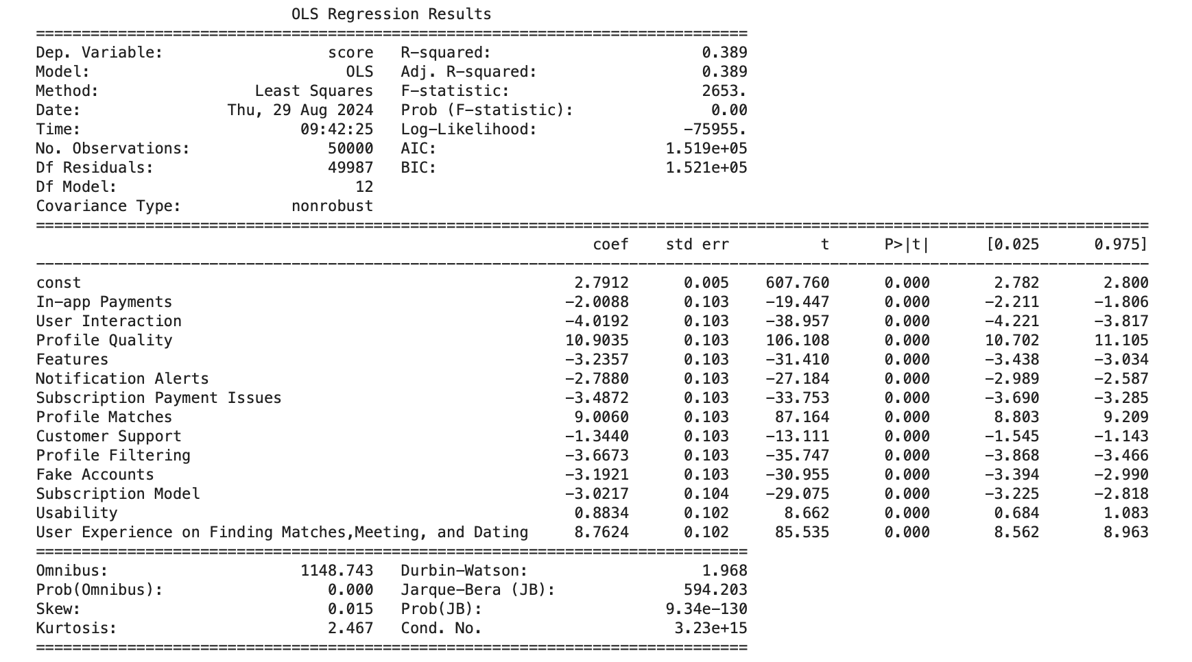
Regression data analysis- with 50K reviews( excluding short reviews)

Slide 13
Part: Inferences derived (- with entire corpus or 50 k data)
Inferences from the OLS Regression Analysis
Model Fit:
R-squared: 0.389 indicates that approximately 38.9% of the variation in the "score" variable can be explained by the included predictor variables. This suggests a moderately strong relationship between the predictors and the outcome.
Variable Significance:
t-values and p-values: All predictor variables have significant t-values and p-values less than 0.001, indicating that they are all statistically significant contributors to the model.
Variable Effects:
Coefficients: The coefficients represent the estimated change in the "score" variable for a one-unit increase in the corresponding predictor variable, holding all other predictors constant. For example, a one-unit increase in "In-app Payments" is associated with a decrease of 2.0088 in the "score."
Positive or negative coefficients: Positive coefficients indicate that an increase in the predictor variable is associated with an increase in the "score," while negative coefficients indicate a decrease.
Overall Model Significance:
F-statistic and p-value: The F-statistic (2653) and its associated p-value (0.00) indicate that the overall model is statistically significant, meaning that the predictors as a group are significantly associated with the "score" variable.
Summary: The regression analysis suggests that the included predictor variables are all significant contributors to the "score" variable and that the model provides a moderately strong fit to the data. The coefficients of the variables indicate their relative importance and the direction of their effects on the "score."

Slide 14
Part: Dominance analysis on Regression model (50k data)
Dominance Analysis
Topic Serial Number | Topic Name | % Importance
Topic 13 | User Experience on Finding Matches, Meeting, Dating | 22.45%
Topic 3 | Profile Quality | 10.79%
Topic 12 | Usability | 9.18%
Topic 1 | In-app Payments | 8.17%
Topic 8 | Customer Support | 7.84%
Topic 7 | Profile Matches | 7.62%
Topic 10 | Fake Accounts | 6.71%
Topic 4 | Features | 6.42%
Topic 5 | Notification Alerts | 6.01%
Topic 2 | User Interaction | 5.08%
Topic 9 | Profile Filtering | 4.55%
Topic 6 | Subscription Payment Issues | 3.02%
Topic 11 | Subscription Model | 2.16%

Slide 15
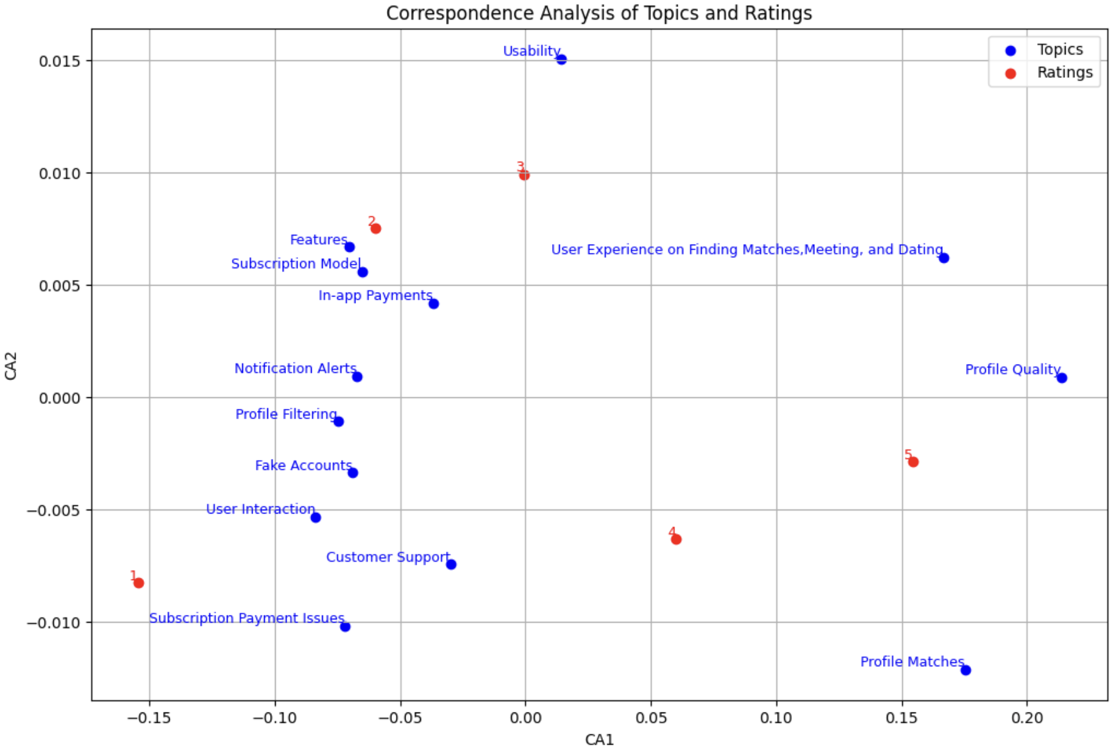
Part: Correspondence analysis (with 50K reviews)

Slide 16
Inferences obtained from Correspondence analysis (50K Reviews)
Insights from the Correspondence Analysis (CA) Plot
Correspondence Analysis (CA) is a multivariate statistical technique used to explore relationships between two categorical variables. In this plot, the two variables are "Topics" and "Ratings."
Key Observations:
Clustering: The plot shows distinct clusters of topics and ratings. This indicates that certain topics tend to be associated with specific ratings.
Topic-Rating Associations:
High Ratings: Topics like "Usability," "User Experience on Finding Matches, Meeting, and Dating," and "Profile Quality" are clustered closer to the top-right corner, suggesting they are associated with higher ratings.
Low Ratings: Topics like "Subscription Payment Issues," "Customer Support," and "Fake Accounts" are clustered closer to the bottom-left corner, indicating they are associated with lower ratings.
Neutral Ratings: Topics like "In-app Payments," "Notification Alerts," and "Profile Filtering" are located near the center of the plot, suggesting they have a more neutral relationship with ratings.
Topic-Topic Relationships: The proximity of topics to each other in the plot also reveals relationships between them. For example, "Subscription Issues" and "Customer Support" are close together, suggesting they might be related or co-occur frequently.
Rating-Rating Relationships: Similarly, the proximity of ratings indicates relationships between them. In this case, the ratings appear to be relatively evenly spaced, suggesting no strong associations between them.
Summary: The CA plot provides valuable insights into the relationships between the topics and ratings. It highlights which topics are associated with higher or lower ratings and reveals potential clusters or groups of topics with similar rating patterns.These findings can be used to understand user preferences, identify areas for improvement, and inform product development decisions.

Slide 17
Google drive link of all codes/data/pre processed data/plots
Provide the link below: https://drive.google.com/drive/folders/1_kSP2wAdyYPoSam48qfX2Iz2XP6CYC_A?usp=share_link

Slide 18
Managerial insights from this text mining project
User Experience Enhancement: The highest frequency of discussions around user experience (20.09%) indicates that this is the primary concern for users. Prioritizing improvements in match-finding, dating, and meeting experiences will directly impact user satisfaction and retention.
Notification and Payment Optimization: Significant attention (10.86% and 10.85%) on notifications and in-app payments reveals that seamless functionality in these areas is crucial. Streamlining notification alerts and payment processes can reduce user friction and improve overall satisfaction.
Profile Quality and Feature Expansion: Users place considerable importance (9.82%) on the quality of profiles and available features. Enhancing these elements can lead to higher engagement and improved perception of the app.
Moderate Focus on User Interaction and Support: While user interaction (8.81%), usability (7.26%) and customer support (8.29%) are not the most discussed, they are still important. Strengthening these areas can contribute to overall user experience and reduce churn.
Addressing Less Frequent but Critical Issues: Although less mentioned, issues like profile filtering (5.13%), subscription problems (2.91%), and fake accounts (2.86%) represent pain points that, if resolved, could lead to a more positive app reputation and lower negative feedback.
Strategic Prioritization: The data suggests focusing on core areas like user experience, notifications, and payments for immediate improvements, while gradually addressing issues with usability, filtering, and subscription models. This targeted approach can optimize resource allocation and enhance user satisfaction effectively.

